Slide 1
CS G513 NETWORK SECURITY
Final Project Evaluation
Security Analysis of Emerging Smart Home Applications
Team 12:
Abhilash Gahankari (2020H1030113H)
Satish Phale (2020H1030155H)

Slide 2
Agenda:
Current Experimental Setup
Dos Attack
Vulnerability
Notes:
The presentation will include the Smartthings intro and ecosystem, architecture, framework. Security analysis that researchers did, four attack that are proof of concepts, key finding s of paper and work proposal.

Slide 3
Current Experimental Setup
The current experimental setup consist of the smart bulb, router/hotspot for wifi access point and mobile companion application.
The Wipro smart bulb has an android mobile companion application named “Wipro Next Smart Home”. By reading on the internet about the device, we also found out that the device is compatible with “Tuya Smart” which is by company Tuya.Inc.
The device does not require any special intermediate hub and connects to applications directly over the internet.
The Tuya Smart application is used throughout the process as the mobile companion application.
Laptop hotspot is used as the wifi access point.

Slide 4
Dos Attack Steps
1. Run the following command to scan the open ports on the device:
nmap -sV -p- 192.168.137.63
2.Check which port is in open state.
3. Try using the above open port for the flood attack as follows:
hping --syn --rand-source --flood -p 6668 192.168.137.63
performing a TCP SYN flood attack and block the user with the registered device from controlling the bulb. This is a type of DoS attack that exploits the TCP three-way handshake by overflowing the bulb with TCP connections faster than it can handle it.
The attack consists of repeated SYN packets sent to 6668, and the smart bulb responds repeatedly with an SYN-ACK. This way the smart bulb is kept “busy” and the owner is not able to connect to it.

Slide 5
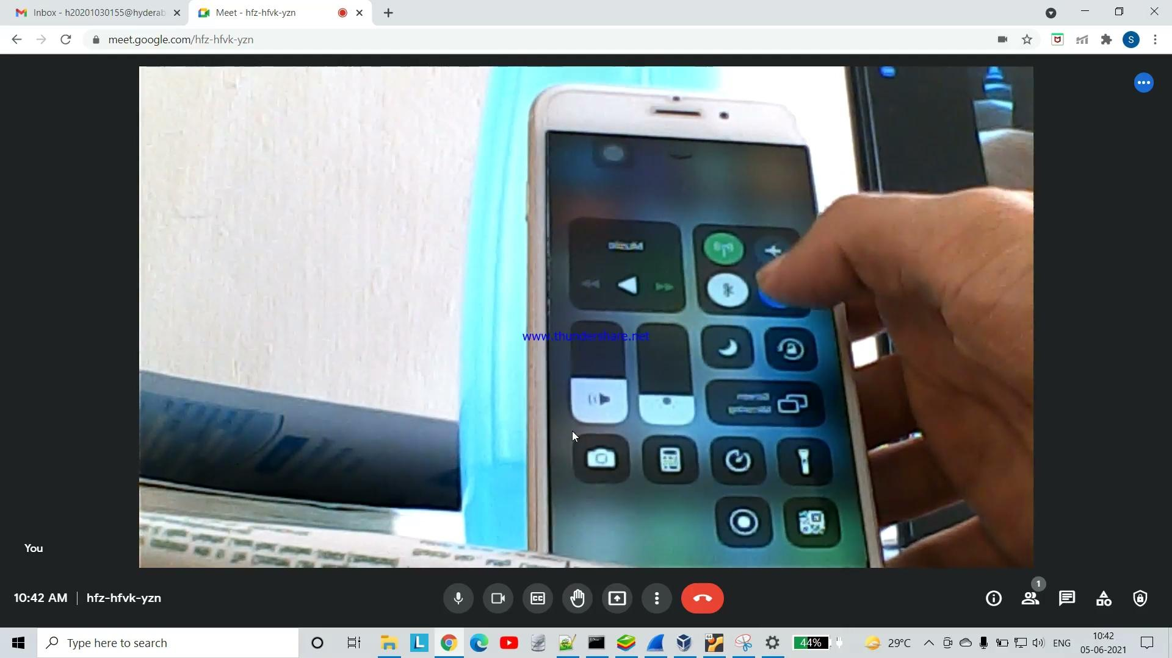
Demo:

Slide 6
Vulnerability :
Steps involve :
You set the smart bulb into a promiscuous listening mode
From a mobile device connected to a WiFi Access Point, you start SmartConfig pairing using the relevant app
Your mobile device encodes your WiFi credentials into sequences of data length values
Your mobile device sends the sequences of broadcast UDP packets to your WiFi AP
The IoT device sniffs the sequences and decodes the data lengths to retrieve the WiFi credentials
The IoT device joins the WiFi network using the credentials and continues communication from there

Slide 7
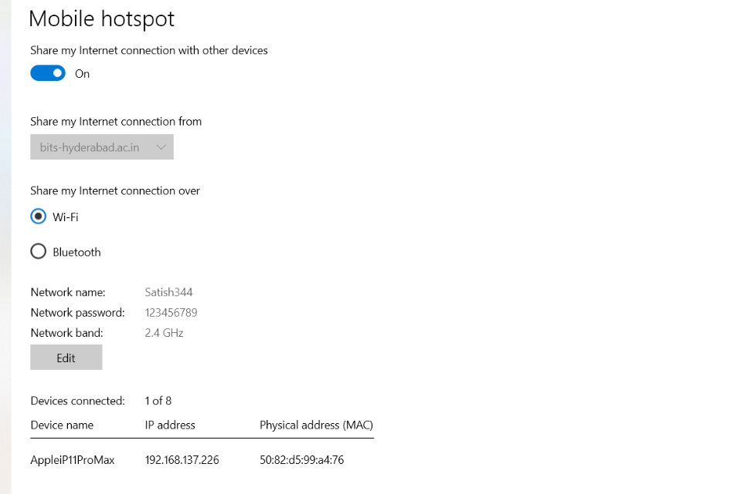

Slide 8
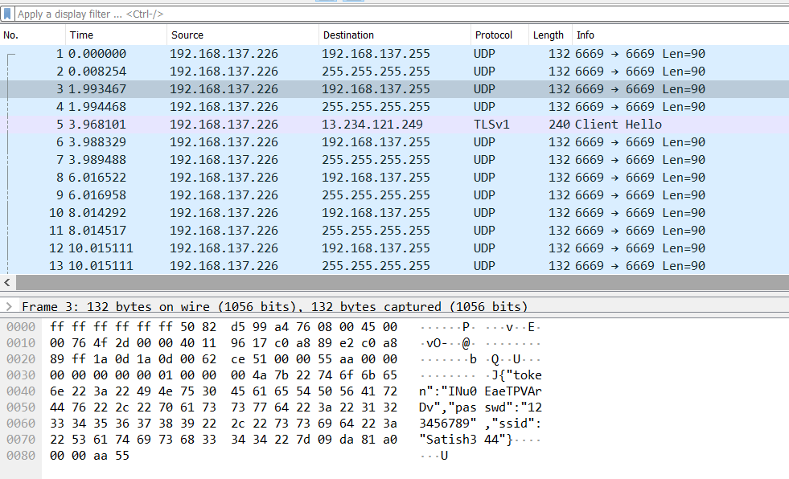

Slide 9
Thank You

